Slide 1
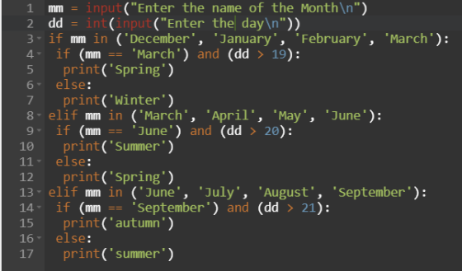
Advanced programming concepts
SL8 string processes

Slide 2
Learning objectives
In this lesson you will learn to:
  Split lines on commas
  Use all the Python string functionality required for the GCSE examination
  Create programs and annotate then to show understanding.
© Pearson Education Ltd 2020. Copying permitted for purchasing institution only.
Notes:
Specification content: 1.2.2 6.3.1 6.3.3 6.4.2

Slide 3

KEY QUESTIONS
String is a data type , can you remember all the different data types ?
What are some of the ways we can manipulate string variables?

Slide 4
What we need to do
Write the programs in Python
Check you have the correct output
Print out the programs and annotate in your books
to show you can understand how to use string manipulation.

Slide 5
You need to be aware of how to use these string subprograms from the PLS
Subprogram | Description
len(<string>) | Returns the length of <string>
<string>.find(<substring>) | Returns the location of <substring> in the original <string>. Returns -1, if not found
<string>.index(<substring>) | Returns the location of <substring> in the original <string>. Raises an exception if not found
<string>.isalpha() | Returns True, if all characters are alphabetic. A–Z
<string>.isalnum() | Returns True, if all characters are alphabetic. A–Z and digits (0–9)
<string>.isdigit() | Returns True, if all characters are digits (0–9). exponents are digits
<string>.replace(<s1>,<s2>) | Returns original string with all occurrences of <s1> replaced with <s2>
<string>.split(<char>) | Returns a list of all substrings in the original, using <char> as the separator
<string>.strip(<char>) | Returns original string with all occurrences of <char> removed from the front and back
<string>.upper() | Returns the original string in uppercase
<string>.lower() | Returns the original string in lowercase
<string>.isupper() | Returns True, if all characters are uppercase
<string>.islower() | Returns True, if all characters are lowercase
<string>.format(<placeholders>) | Formats values and puts them into the <placeholders>
© Pearson Education Ltd 2020. Copying permitted for purchasing institution only.

Slide 6
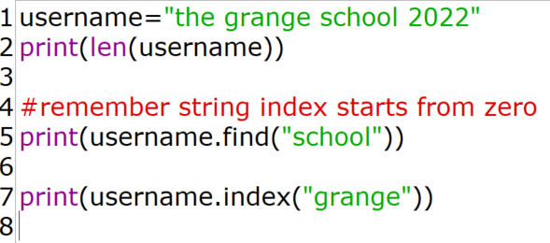

len(<string>)
Returns the location of <substring> in the original <string>. Raises an exception if not found
© Pearson Education Ltd 2020. Copying permitted for purchasing institution only.
Notes:
Tutor: Consider using the debugger and a breakpoint to show how the user’s Table looks in memory. Fields are sometimes referred to as columns or attributes.

Slide 7
<string>.find(<substring>)
Returns the location of <substring> in the original <string>. Returns -1, if not found
© Pearson Education Ltd 2020. Copying permitted for purchasing institution only.

Slide 8
<string>.index(<substring>)
Returns the location of <substring> in the original <string>. Raises an exception if not found
© Pearson Education Ltd 2020. Copying permitted for purchasing institution only.
Notes:
Tutor: Consider using the debugger and a breakpoint to show how the user’s Table looks in memory. Fields are sometimes referred to as columns or attributes.

Slide 9
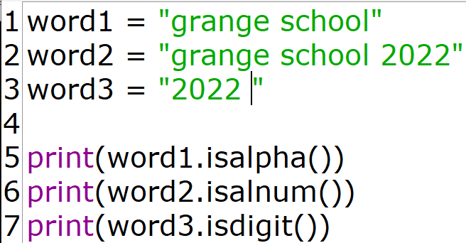

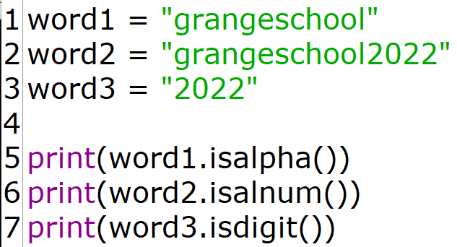

<string>.isalpha()
Returns True, if all characters are alphabetic. A–Z
<string>.isalnum()
Why are these false?
Returns True, if all characters are alphabetic. A–Z and digits (0–9)
<string>.isdigit()
Returns True, if all characters are digits (0–9). exponents are digits
© Pearson Education Ltd 2020. Copying permitted for purchasing institution only.
Notes:
Tutor: Consider using the debugger and a breakpoint to show how the user’s Table looks in memory. Fields are sometimes referred to as columns or attributes.

Slide 10
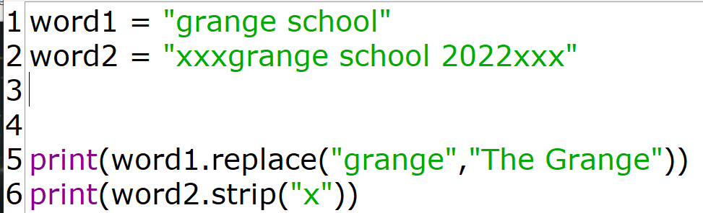
replace and strip
<string>.replace(<s1>,<s2>)
Returns original string with all occurrences of <s1> replaced with <s2>
<string>.strip(<char>)
Returns original string with all occurrences of <char> removed from the front and back
© Pearson Education Ltd 2020. Copying permitted for purchasing institution only.
Notes:
Tutor: Consider using the debugger and a breakpoint to show how the user’s Table looks in memory. Fields are sometimes referred to as columns or attributes.

Slide 11
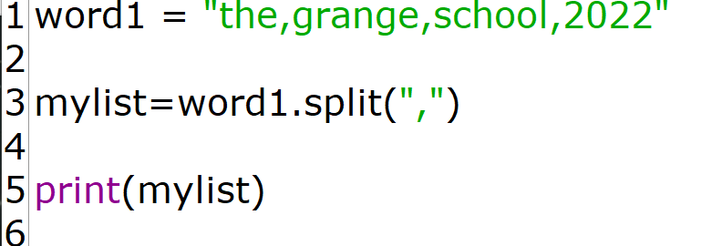


Breaking up a string
<string>.split()
  Takes the character in brackets as the point at which to break the string (in this case a comma).
  Returns an array of strings, where each member is an item in the original string.
The variable to store the array
The original string
The character to split on
© Pearson Education Ltd 2020. Copying permitted for purchasing institution only.

Slide 12
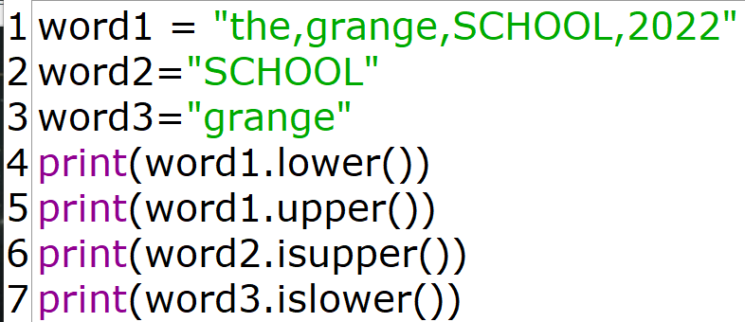
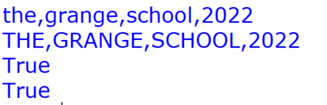
Upper and lower
<string>.upper()
Returns the original string in uppercase
<string>.lower()
Returns the original string in lowercase
<string>.isupper()
Returns True, if all characters are uppercase
<string>.islower()
Returns True, if all characters are lowercase
© Pearson Education Ltd 2020. Copying permitted for purchasing institution only.

Slide 13
Bringing it together
Now that you can split a string,
Once split a string into a list, the string can be converted to the correct data types before being appended to a record.
© Pearson Education Ltd 2020. Copying permitted for purchasing institution only.
Notes:
Student Activity 2

Slide 14
Wrap up: you have learned how to…
Split lines on commas.
  The <string>.split() function breaks up a single string into a list of individual strings, using the argument in brackets as the split character.
Store items in string as a list.
  Once split, items can be converted to the correct data types.
© Pearson Education Ltd 2020. Copying permitted for purchasing institution only.

